Slide 1

NUS Classroom4U NUS Fintech Dev II Project Team 4: Moses Wu, Reginald Oh, Sim Teng Leong

Slide 2


NUS Classroom4U Service Platform
Students’ Database
Name Age Subjects Interested Study Level (E.g) Mobile number Email address Postal Code
Match students (clients) to our in-house tutors.

Slide 3
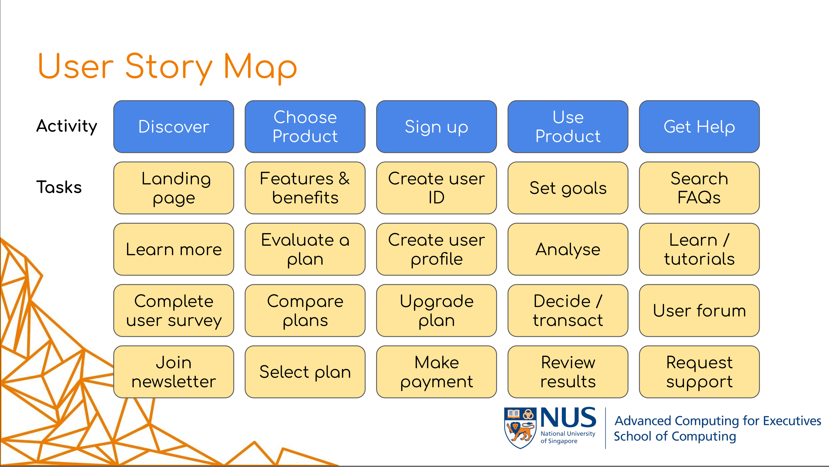
Service Platform Setup
Frontend Design:
?????
Backend Design:
For now only us will access the backend BD.
We are focusing on the “Discovery” stage of user story.
Process:
Students register with us.
Us respond to the enquiry (using the backend DB).
Students, for now will not be accessing their records in the frontend.
Notes:
https://github.com/jscheele/nusmoneysample

Slide 4
Frontend HTML
e.g. Financial HTML example
YAML
e.g. financial planning
Node JS
App.js
DB

Slide 5
Thank You.

Slide 6
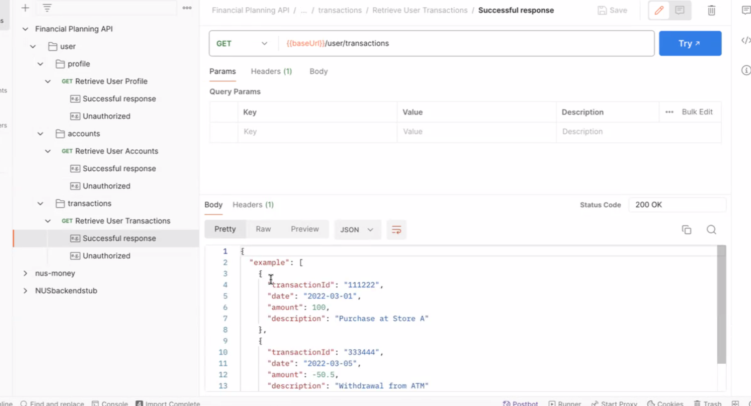
Notes:
design an Open API Specification for an API to provide user profile, account details and transactions from a back end server to a front end web application for a financial planning app

Slide 7
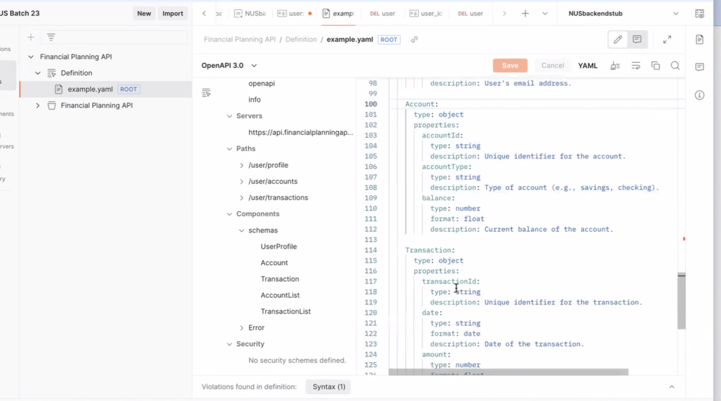
Notes:
Example of paths and schema

